Slide 1
Capital Expenditure VS Revenue Expenditure
Name :V.Srinidhi
Roll.no:125124672100

Slide 2
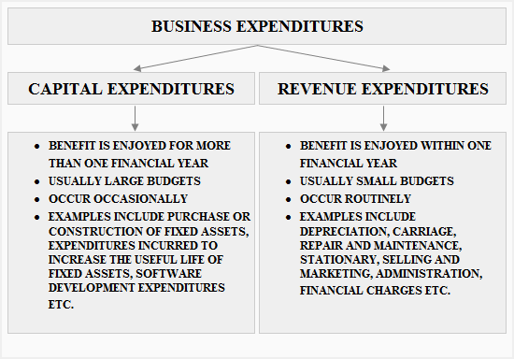
Introduction to Expenditures
Expenditures can be classified into two main categories: capital and revenue.
Understanding the differences between these types is crucial for financial management.
This presentation will explore the definitions, characteristics, and implications of each type of expenditure.
Notes:
Image source: https://www.accountingformanagement.org

Slide 3

What is Capital Expenditure?
Capital expenditure refers to funds used by an organization to acquire or upgrade physical assets.
This type of expenditure is typically associated with long-term investments in property, plant, and equipment.
Examples include purchasing machinery, buildings, or vehicles that enhance operational capacity.
Notes:
Image source: https://c8.alamy.com

Slide 4
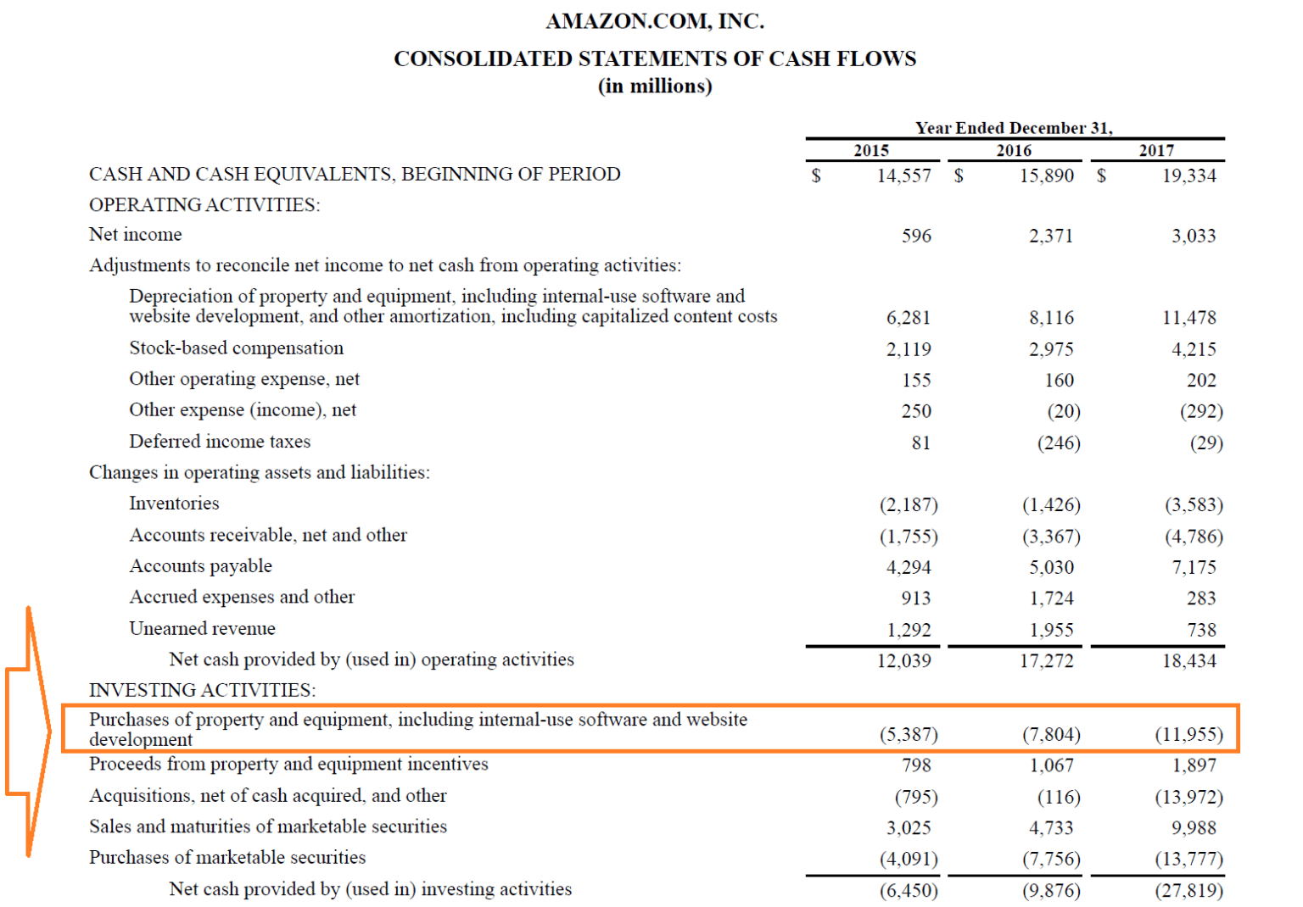
Characteristics of Capital Expenditure
Capital expenditures usually require a significant outlay of cash or resources.
They are recorded as assets on the balance sheet and depreciated over time.
These expenditures are often subject to budgeting and require detailed planning.
Notes:
Image source: https://pray.gelorailmu.com

Slide 5
What is Revenue Expenditure?
Revenue expenditure refers to the costs incurred for the day-to-day functioning of a business.
This type of expenditure is typically short-term in nature and does not lead to asset creation.
Examples include salaries, rent, and utility bills that maintain operational efficiency.
Notes:
Image source: https://study925.com

Slide 6
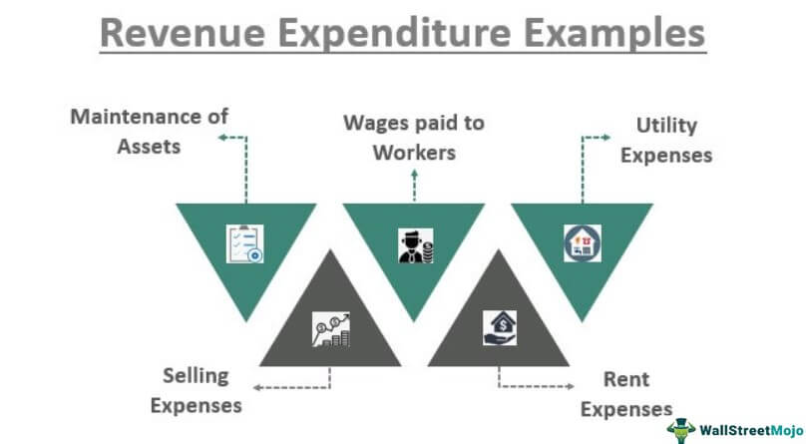
Characteristics of Revenue Expenditure
Revenue expenditures are usually smaller in amount compared to capital expenditures.
They are recorded as expenses on the income statement and affect profit in the current period.
These expenditures are necessary for maintaining ongoing operations and generating revenue.
Notes:
Image source: https://study925.com

Slide 7
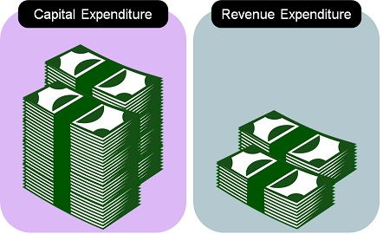
Key Differences Between Capital and Revenue Expenditure
Capital expenditure is focused on asset acquisition, while revenue expenditure is concerned with operational costs.
The impact on financial statements differs: capital expenditures capitalize, whereas revenue expenditures are expensed.
Capital expenditures are long-term investments, whereas revenue expenditures are short-term and recurring.
Notes:
Image source: https://keydifferences.com

Slide 8
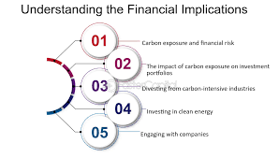
Financial Implications
Capital expenditures can improve a company's capacity and efficiency over time.
Revenue expenditures, while necessary, do not contribute to long-term asset value.
Proper classification of expenditures is essential for accurate financial analysis and reporting.
Notes:
Image source: https://www.slidemake.com

Slide 9
Real-World Examples
A company investing in a new factory represents capital expenditure aimed at expanding production.
Conversely, monthly office supply purchases are classified as revenue expenditures necessary for daily operations.
Each type of expenditure serves a distinct role in the overall financial strategy of an organization.
Notes:
Image source: https://pray.gelorailmu.com

Slide 10
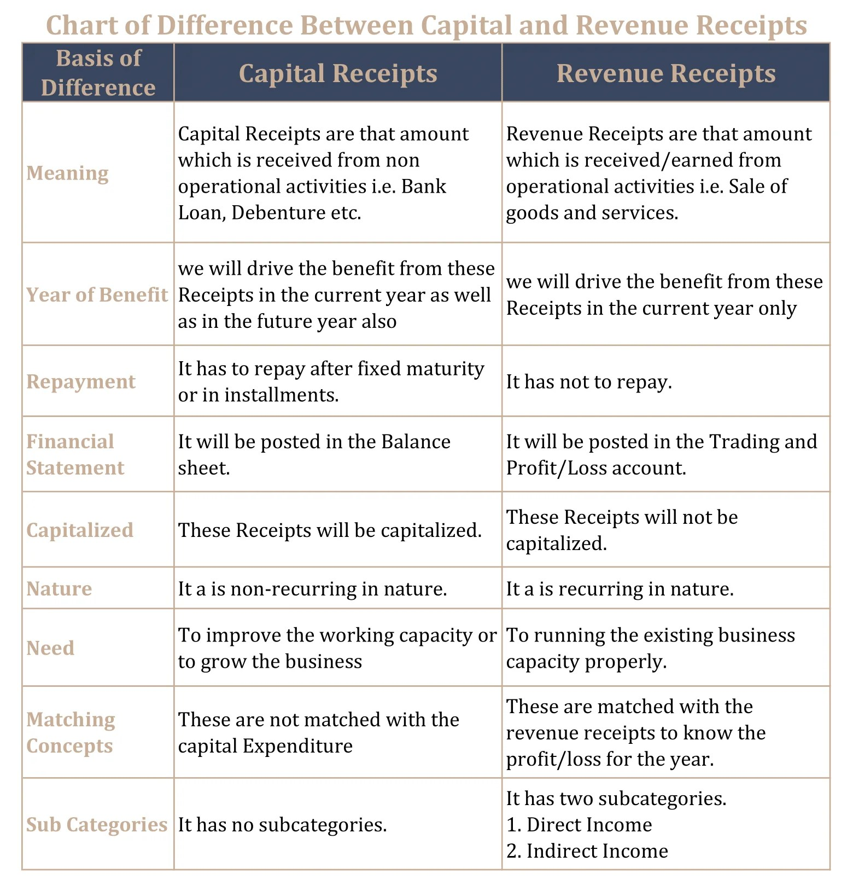
Conclusion
Understanding the differences between capital and revenue expenditures is essential for financial planning.
Both types of expenditures play critical roles in an organization’s strategy and operations.
Accurate classification and management of these expenditures contribute to long-term sustainability and profitability.
Notes:
Image source: https://i0.wp.com

Slide 11


